Slide 1

REST API Architectural constraints
Sit Dolor Amet

Slide 2
caching

Slide 3
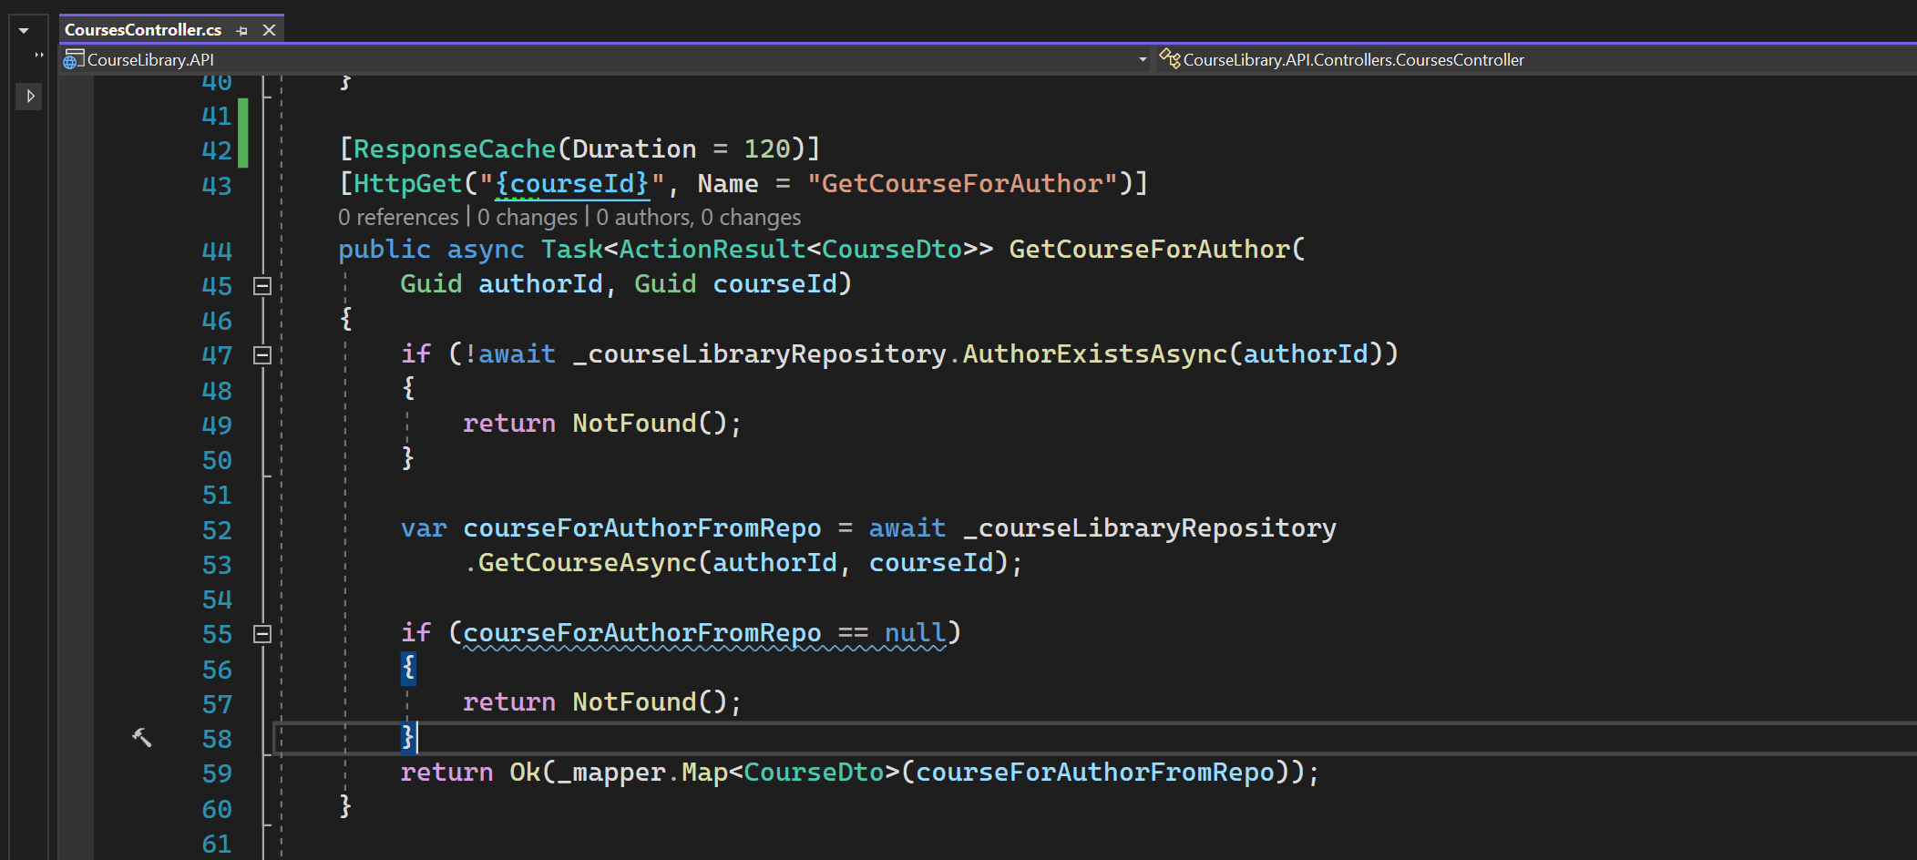
Adding cache headers

Slide 4
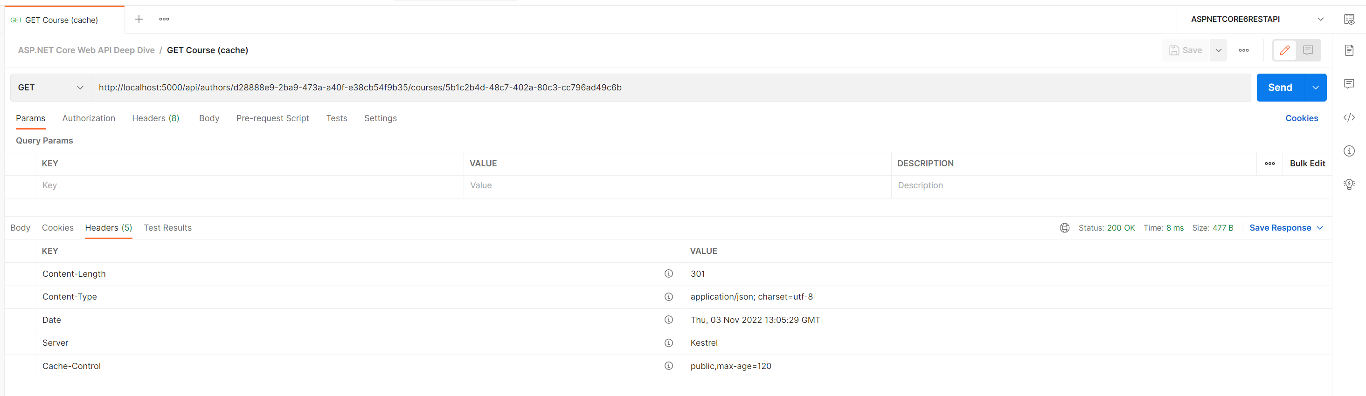
Cache-control
public means it can be used by both shared and private cache

Slide 5
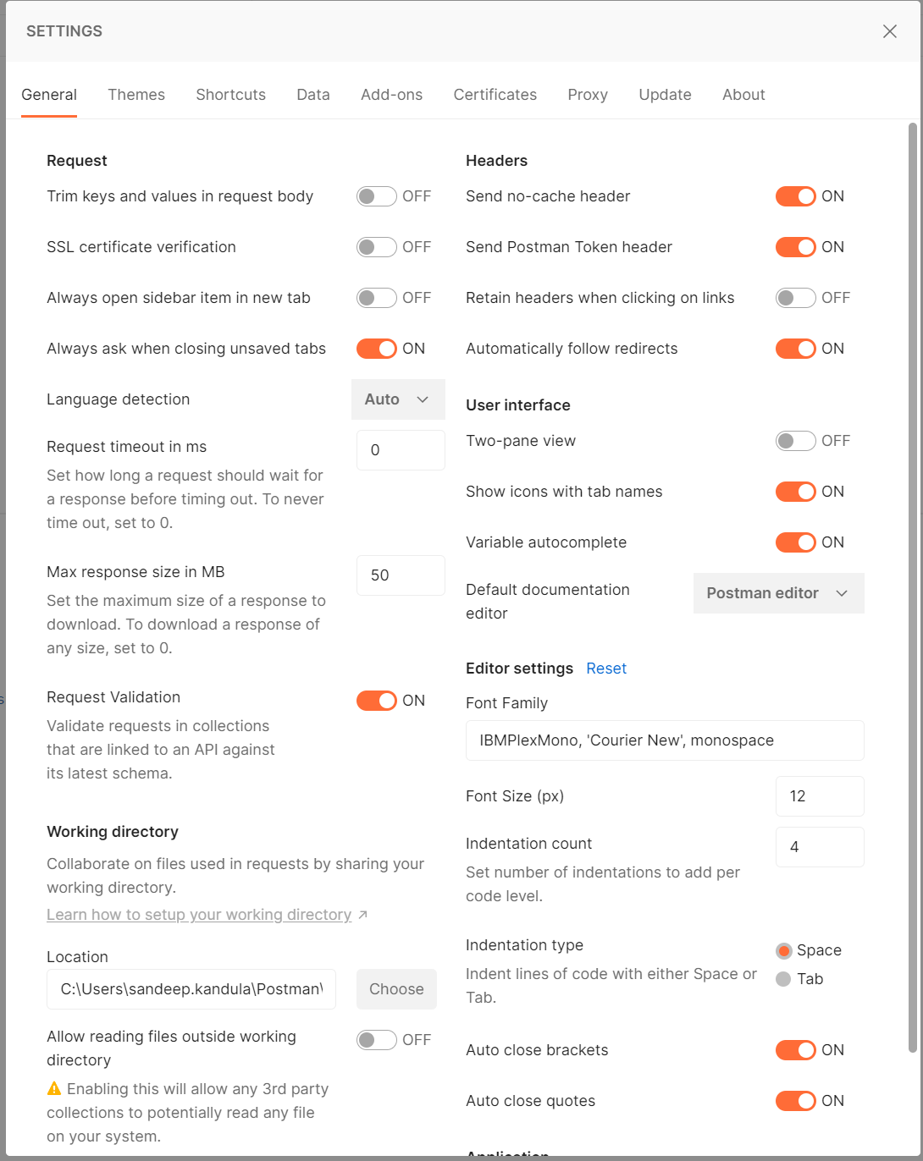
DEFAULT POST MAN SETTINGS

Slide 6
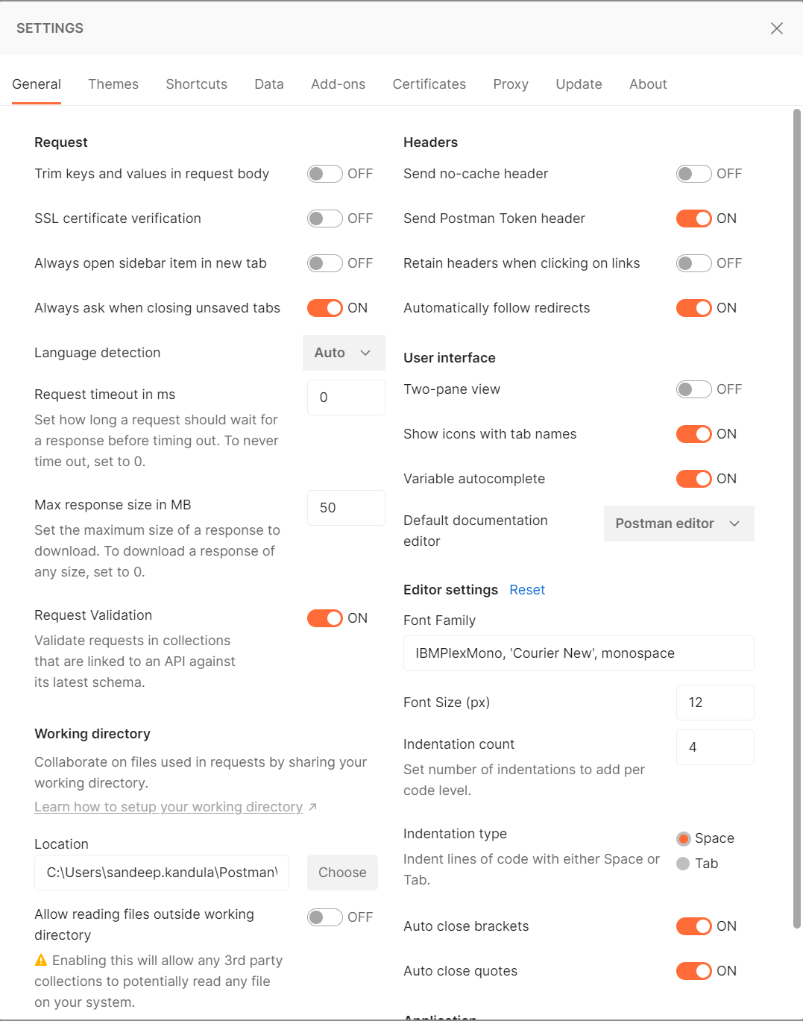
Send no cache header to off

Slide 7
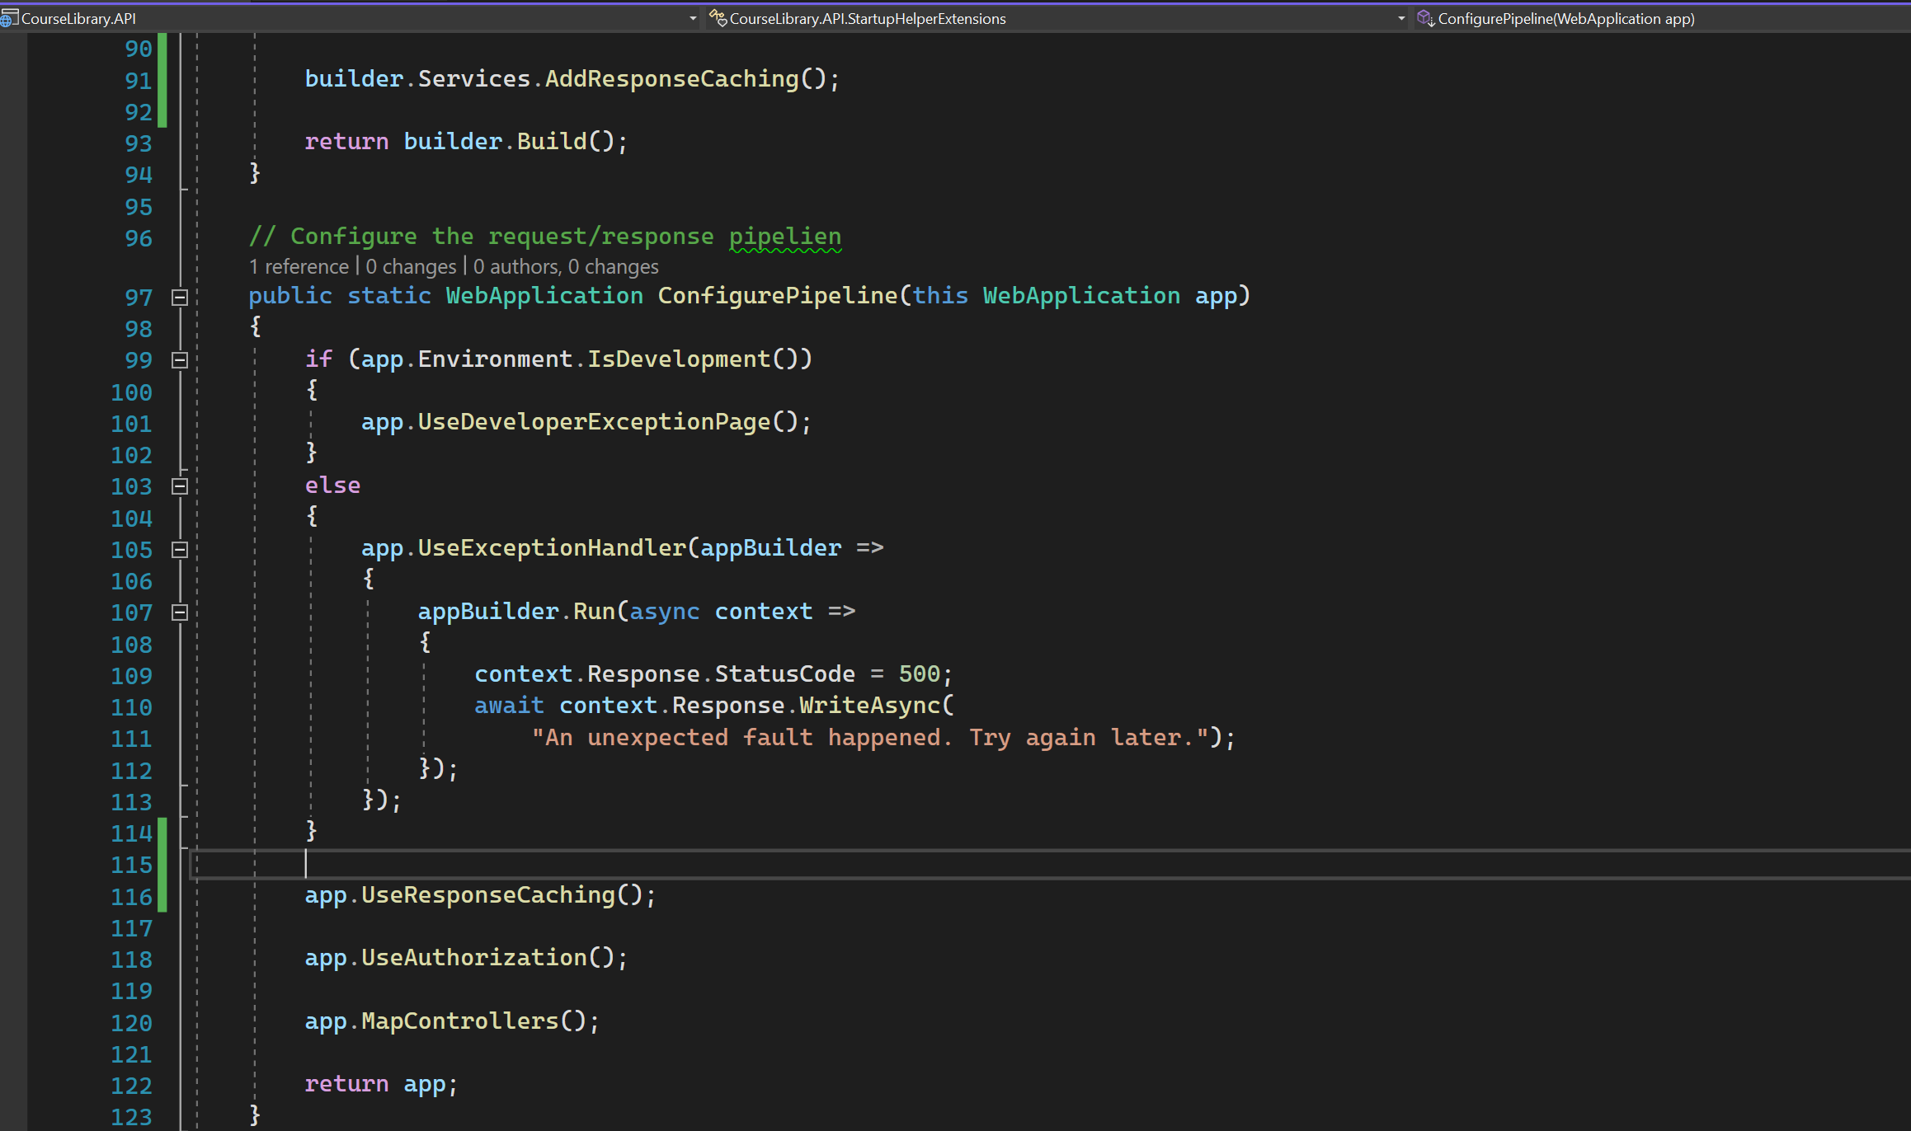
For cache to work, need to use cache store

Slide 8
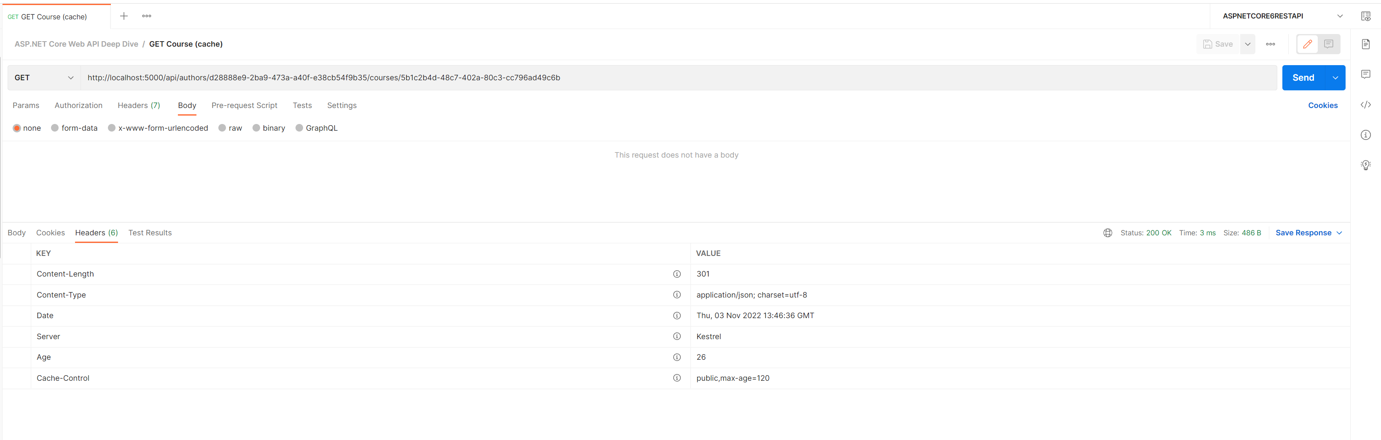
OBSERVE AGE
Will hit the backend after age expires.

Slide 9
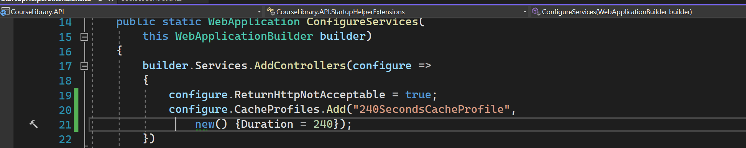
Cache profile - 1

Slide 10
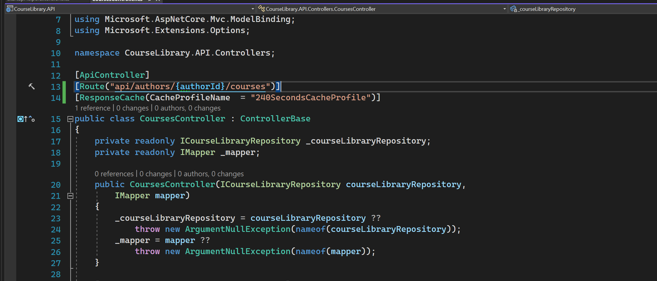
Cache profile - 2

Slide 11
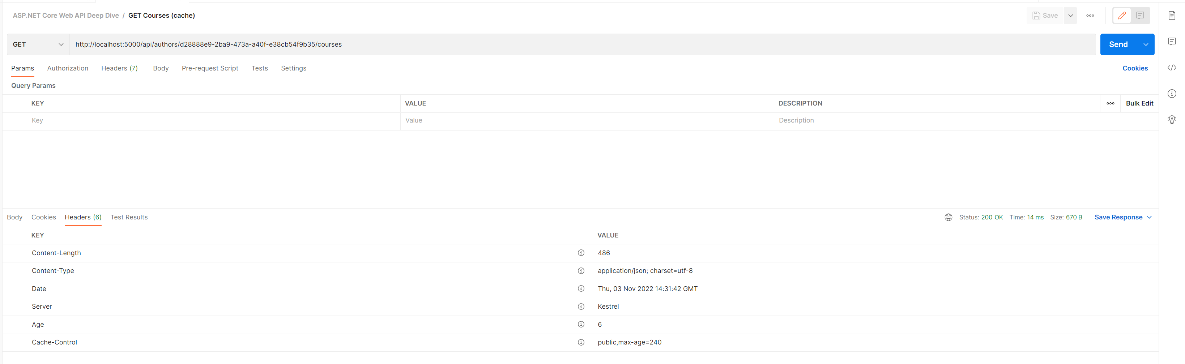
Cache profile - 3

Slide 12
Marvin caching (Full support for rest api)

Slide 13
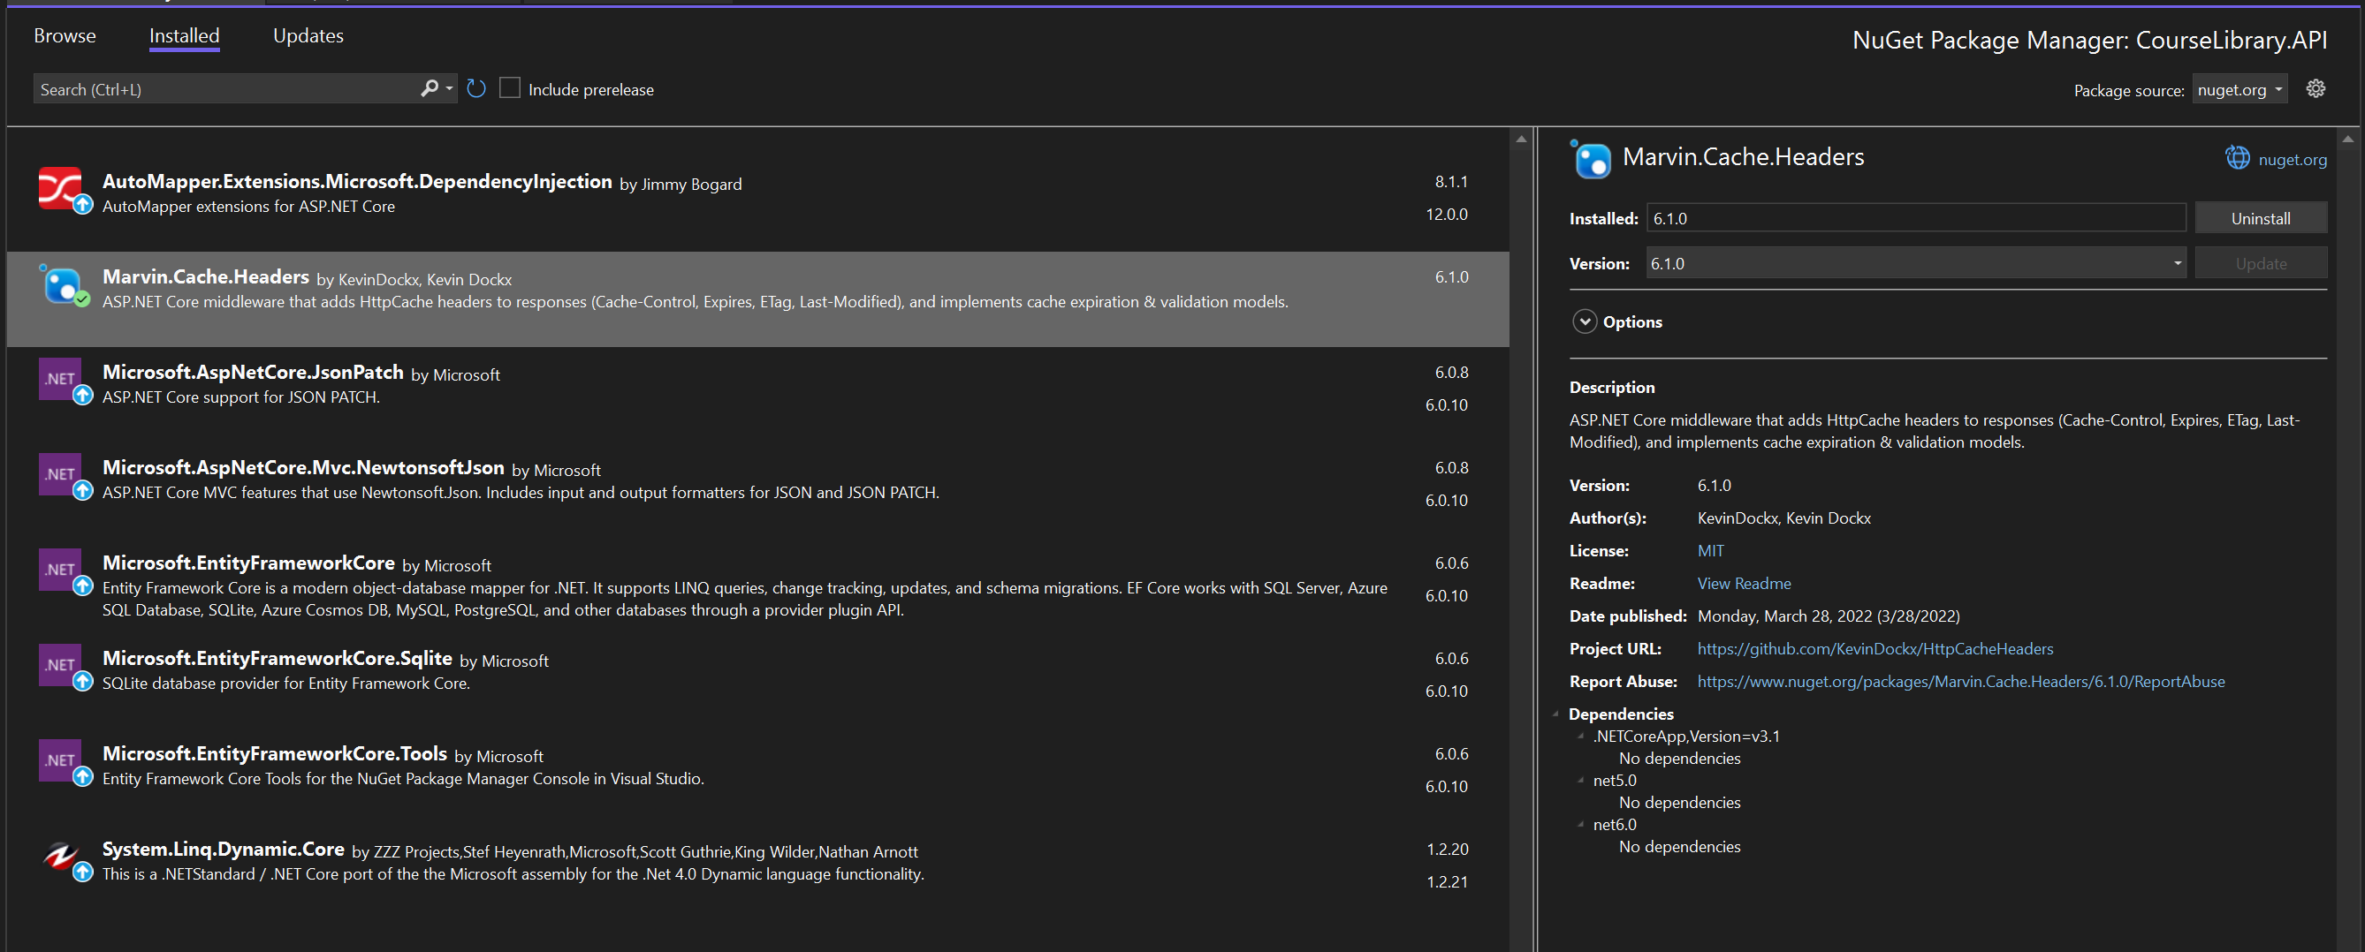
Add NUGET PACKAGE

Slide 14
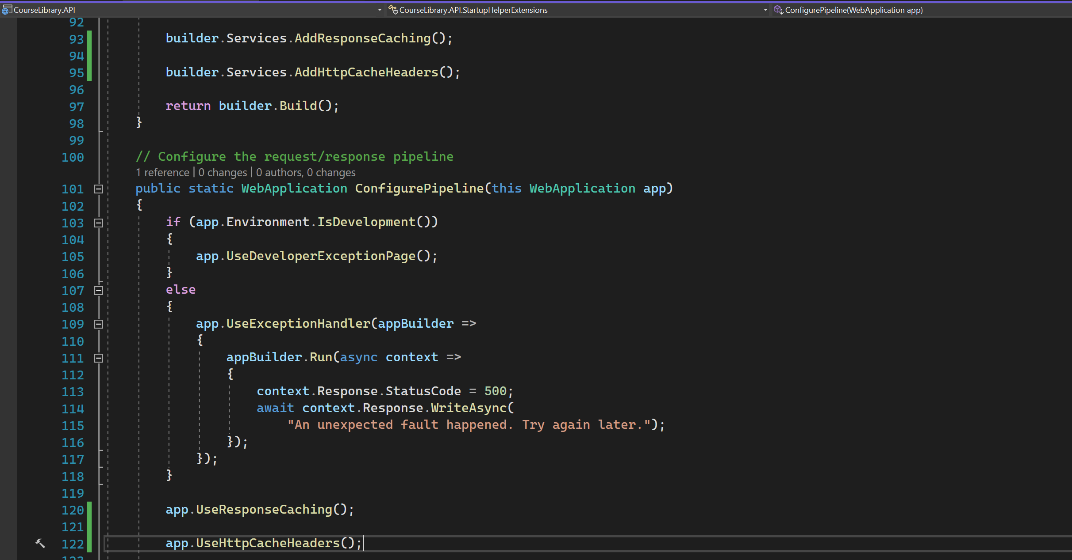
CACHE HEADERS

Slide 15
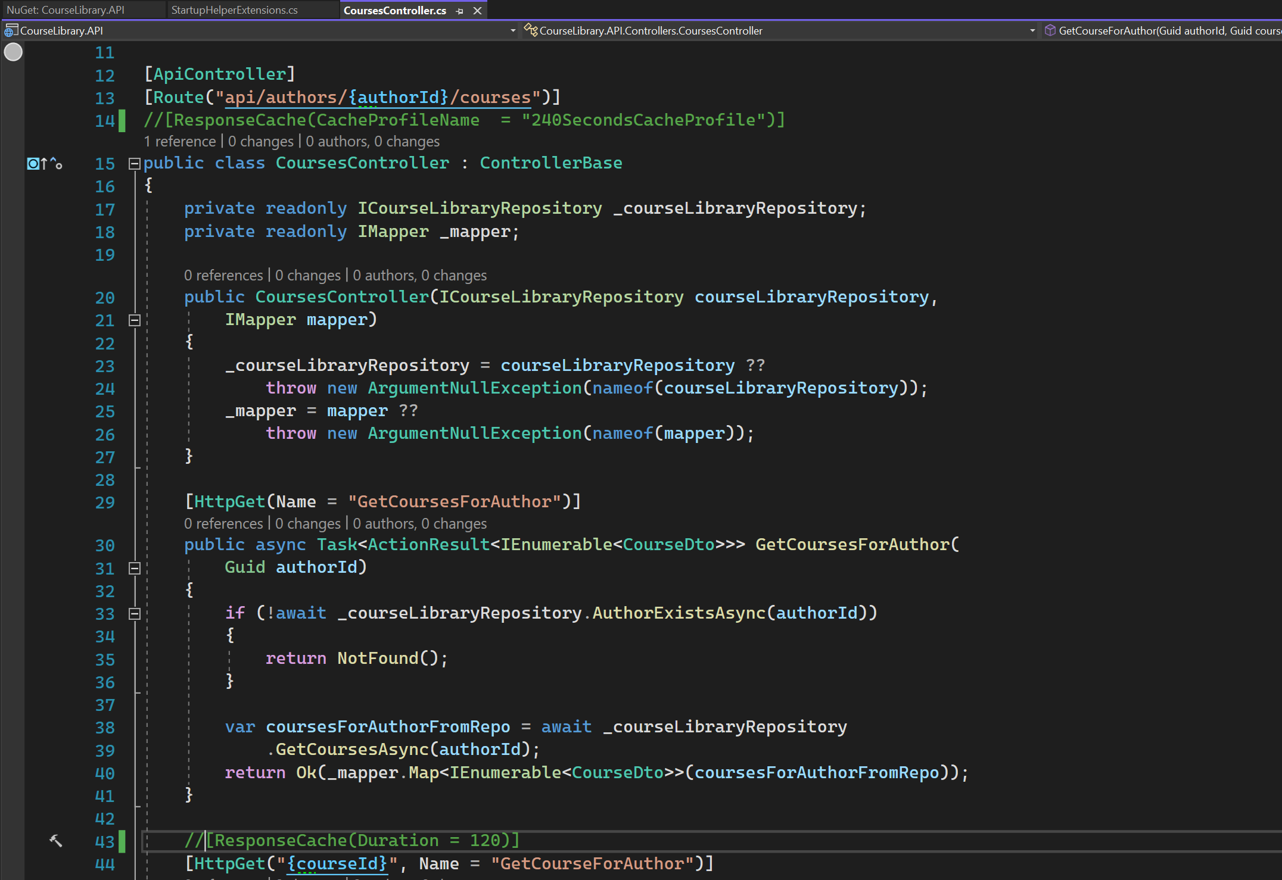
Comment down the response caches (Attributes)

Slide 16
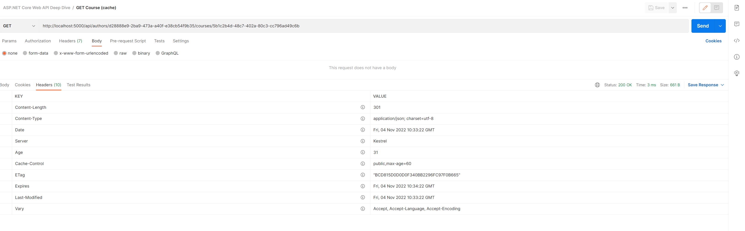
ETAG headers

Slide 17
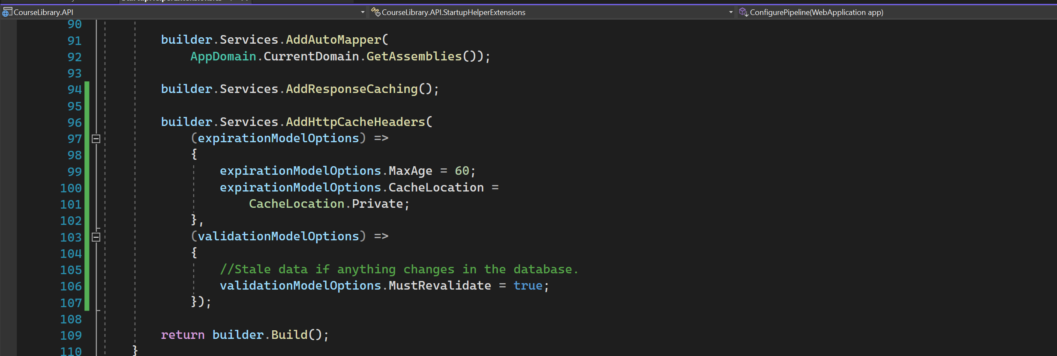
Global cache header configuration - 1

Slide 18
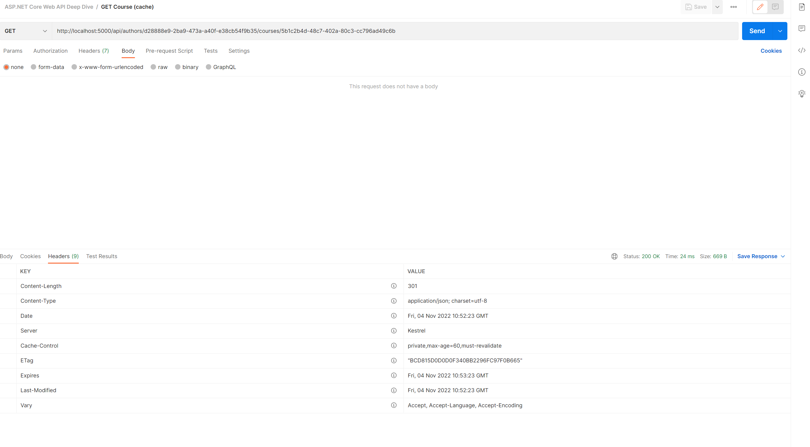
Global cache header configuration - 2

Slide 19
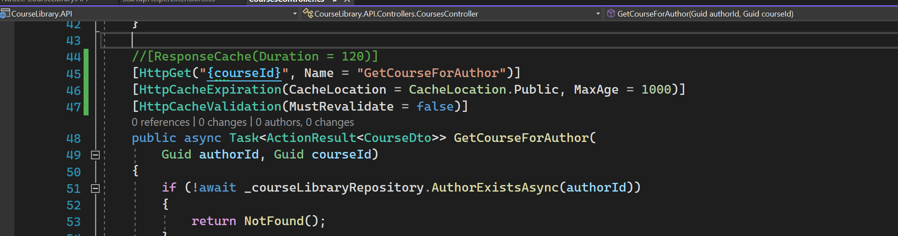
Resource level cache header configuration - 1

Slide 20
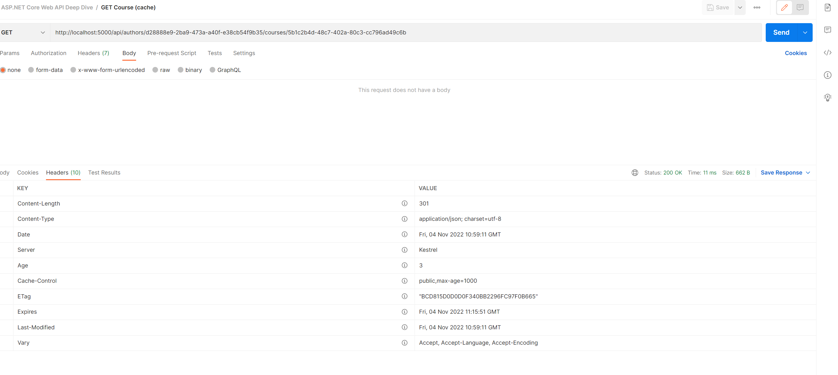
Resource level cache header configuration - 2

Slide 21
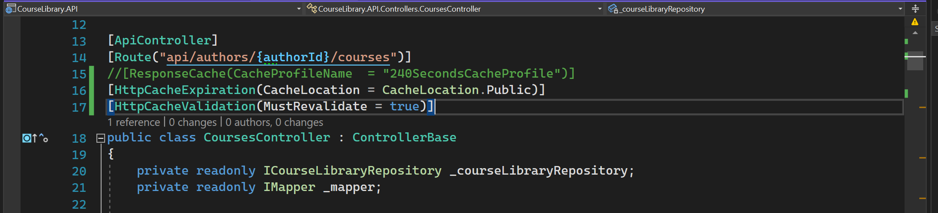
Resource level cache header configuration - 3

Slide 22
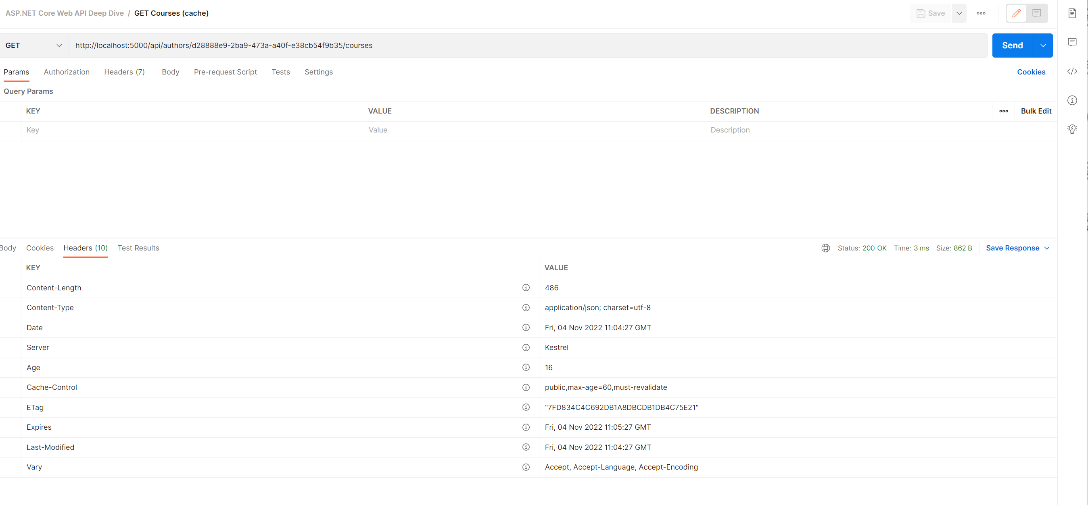
Resource level cache header configuration - 4

Slide 23
CACHE
Works across XML and JSON independently.
JSON cache and XML cache.

Slide 24
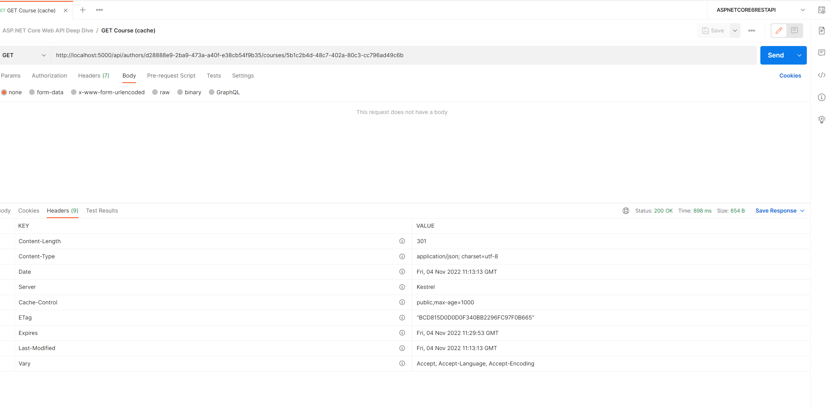
VALIDATE MODEL - 1

Slide 25
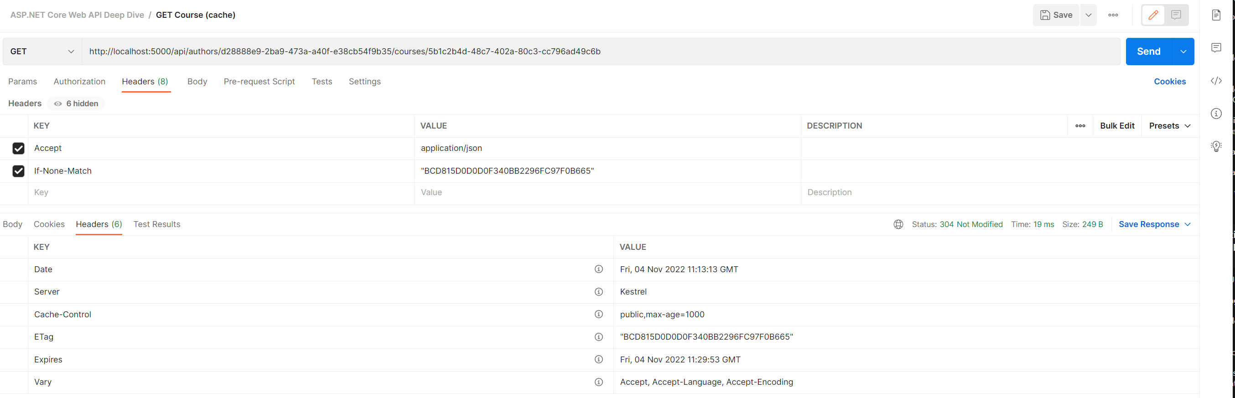
VALIDATE MODEL - 2

Slide 26
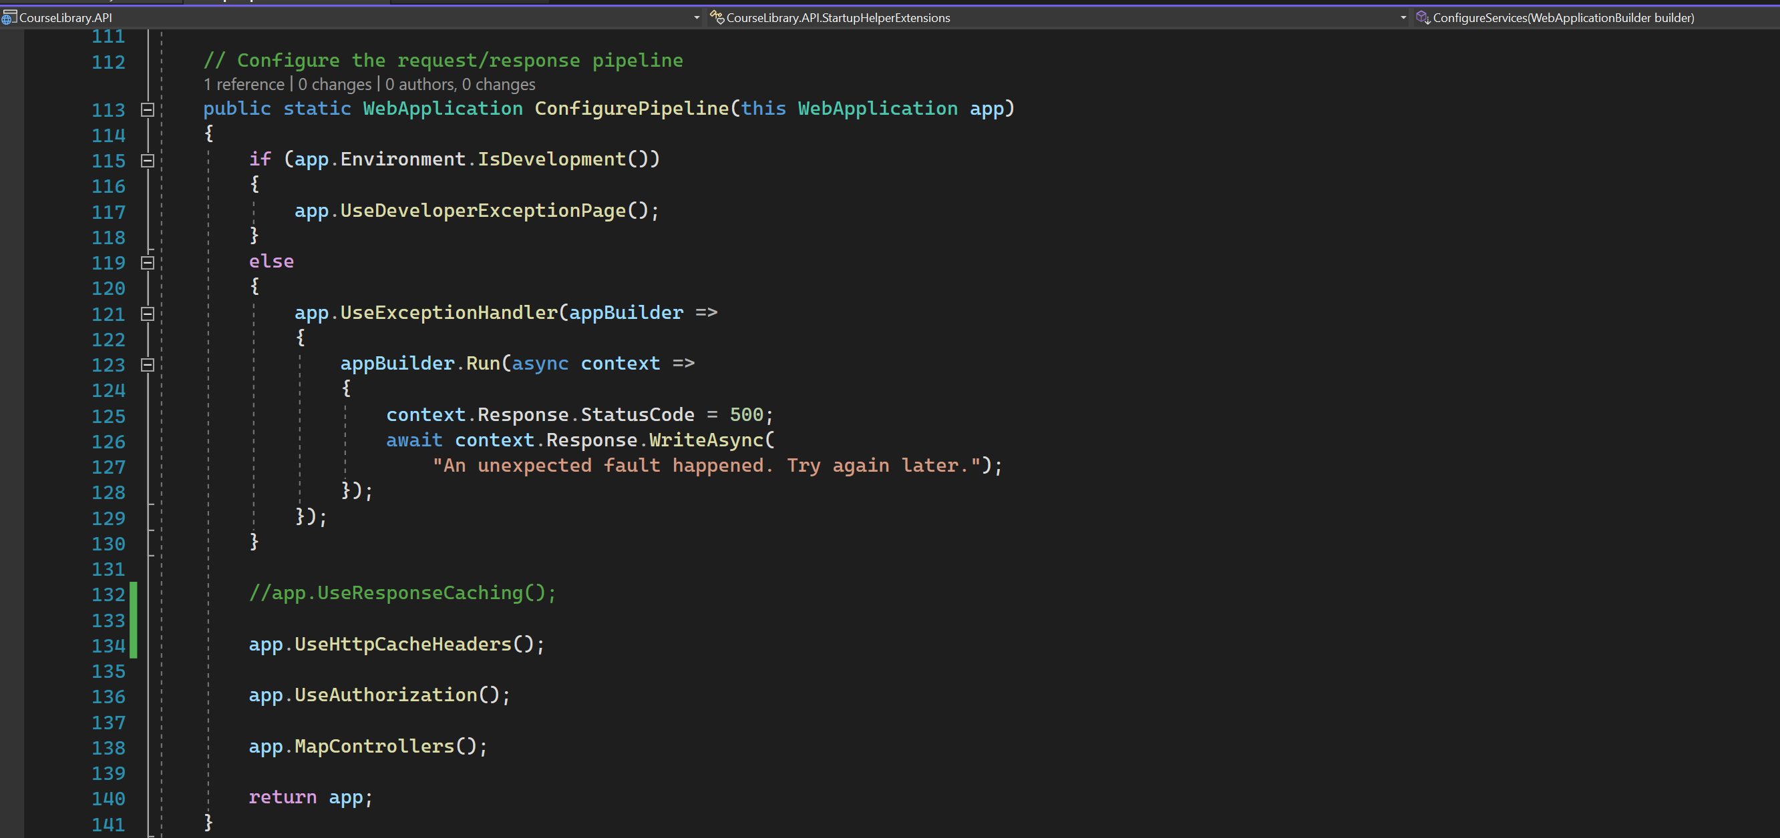
IMPROVE PERFORMANCE - 1

Slide 27
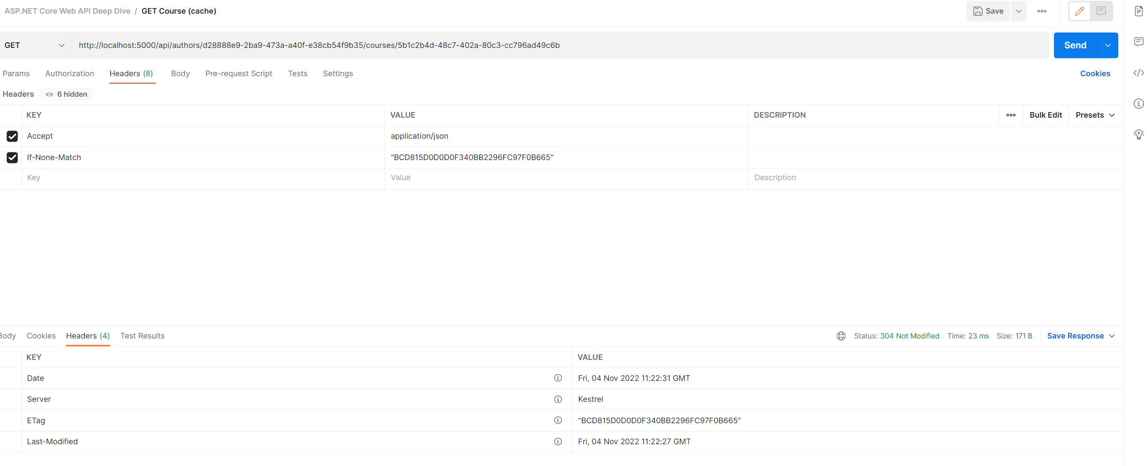
IMPROVE PERFORMANCE - 2

Slide 28
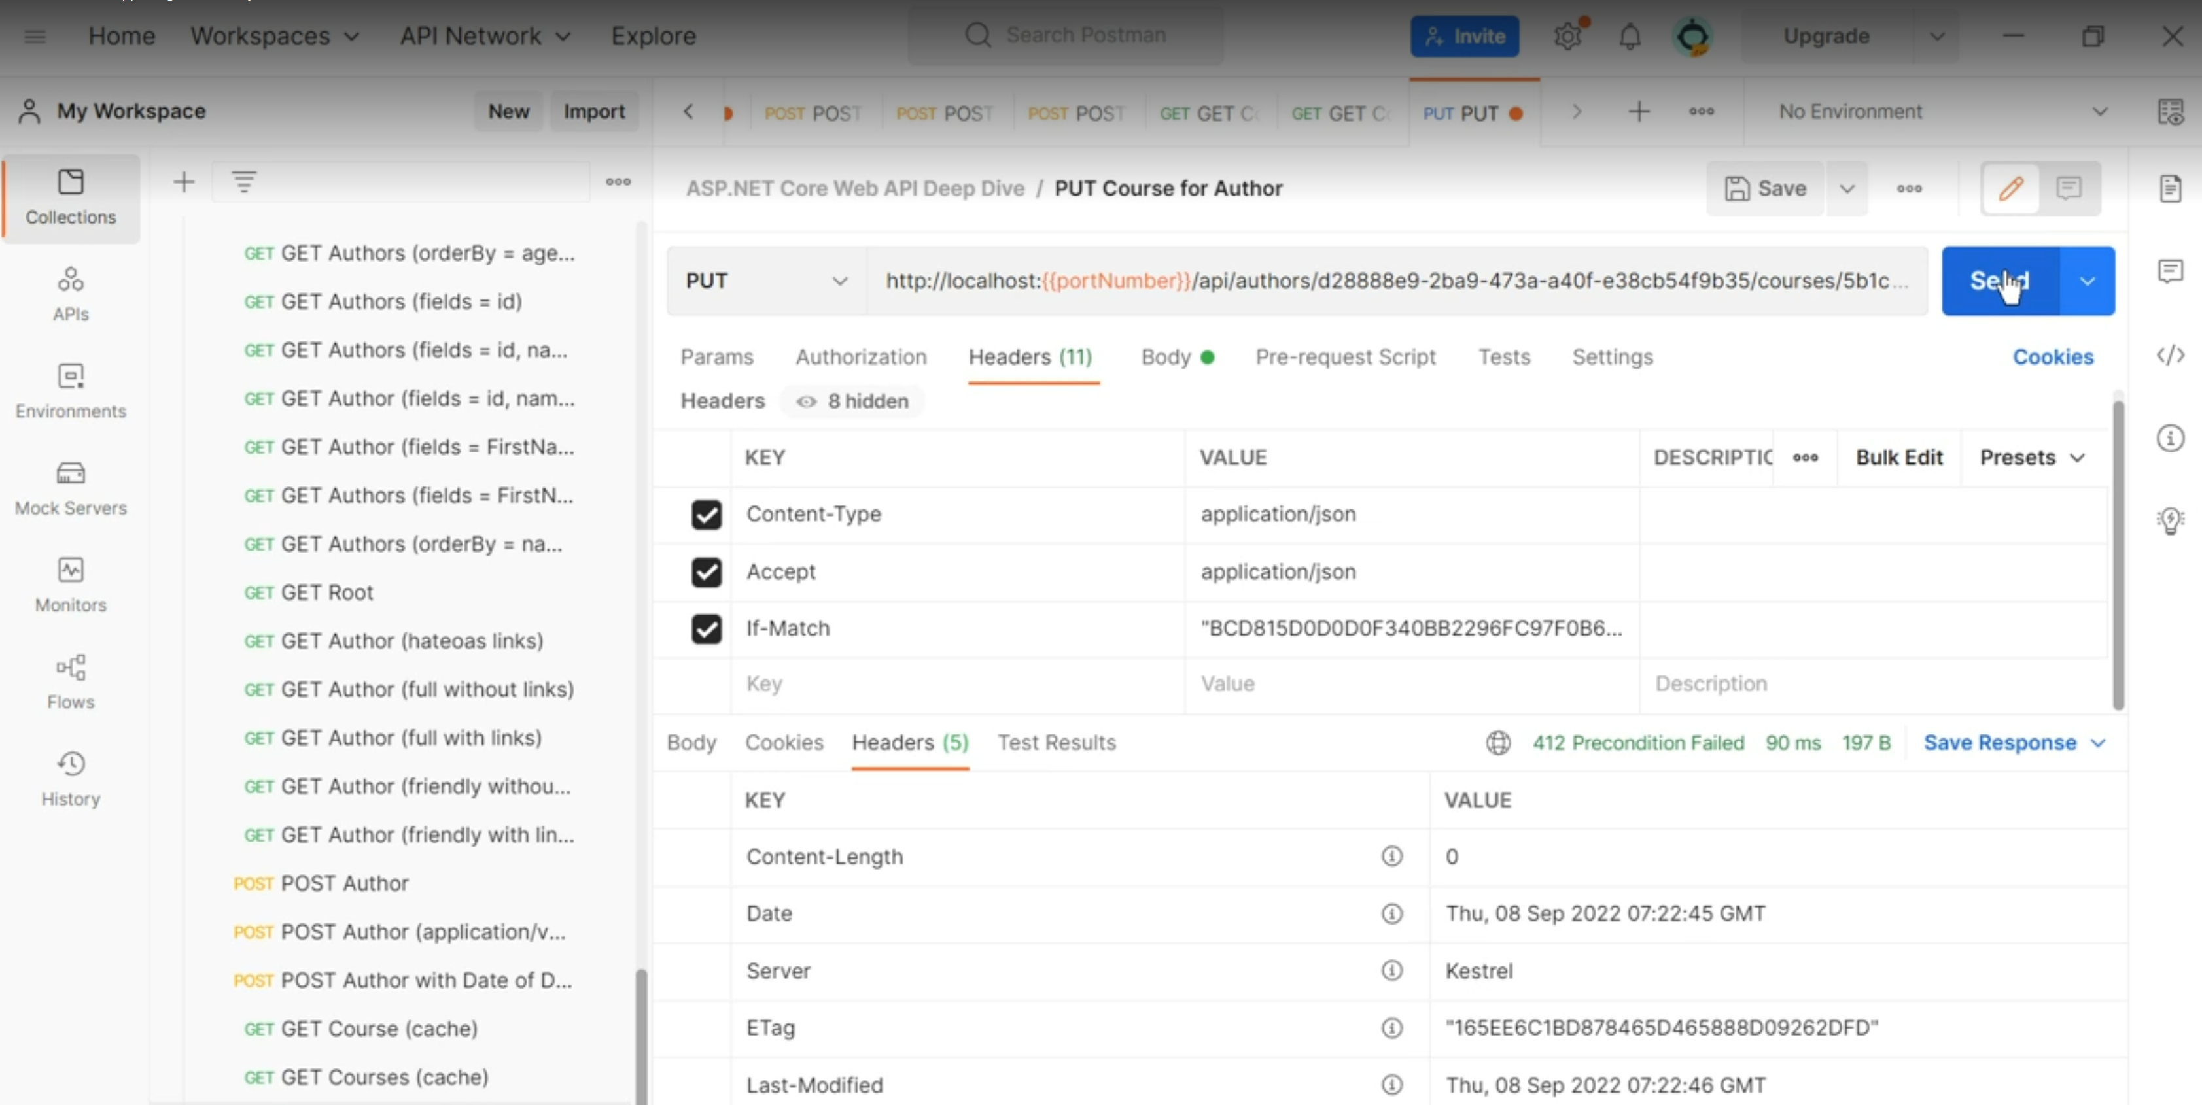
CONCURRENCY

Slide 29
validation

Slide 30
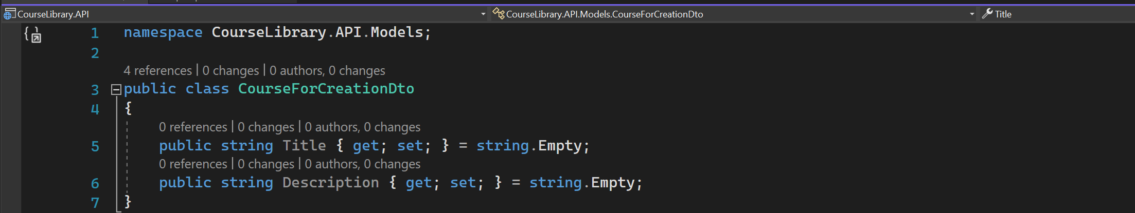
COureseforcreationdto

Slide 31
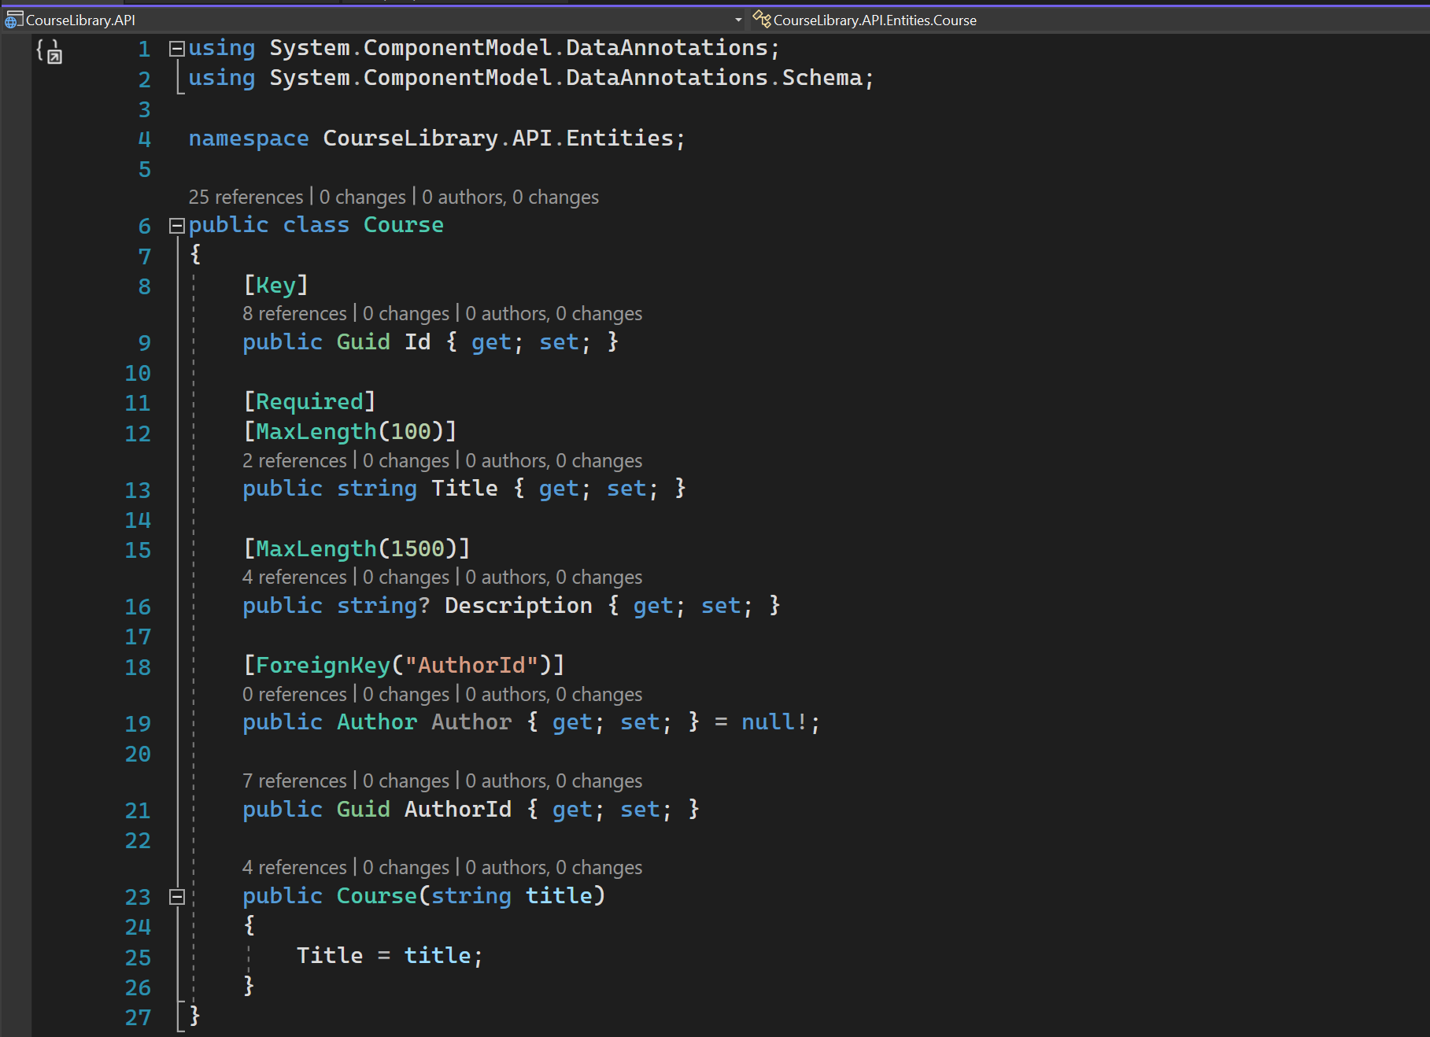
COURSE ENTITY

Slide 32
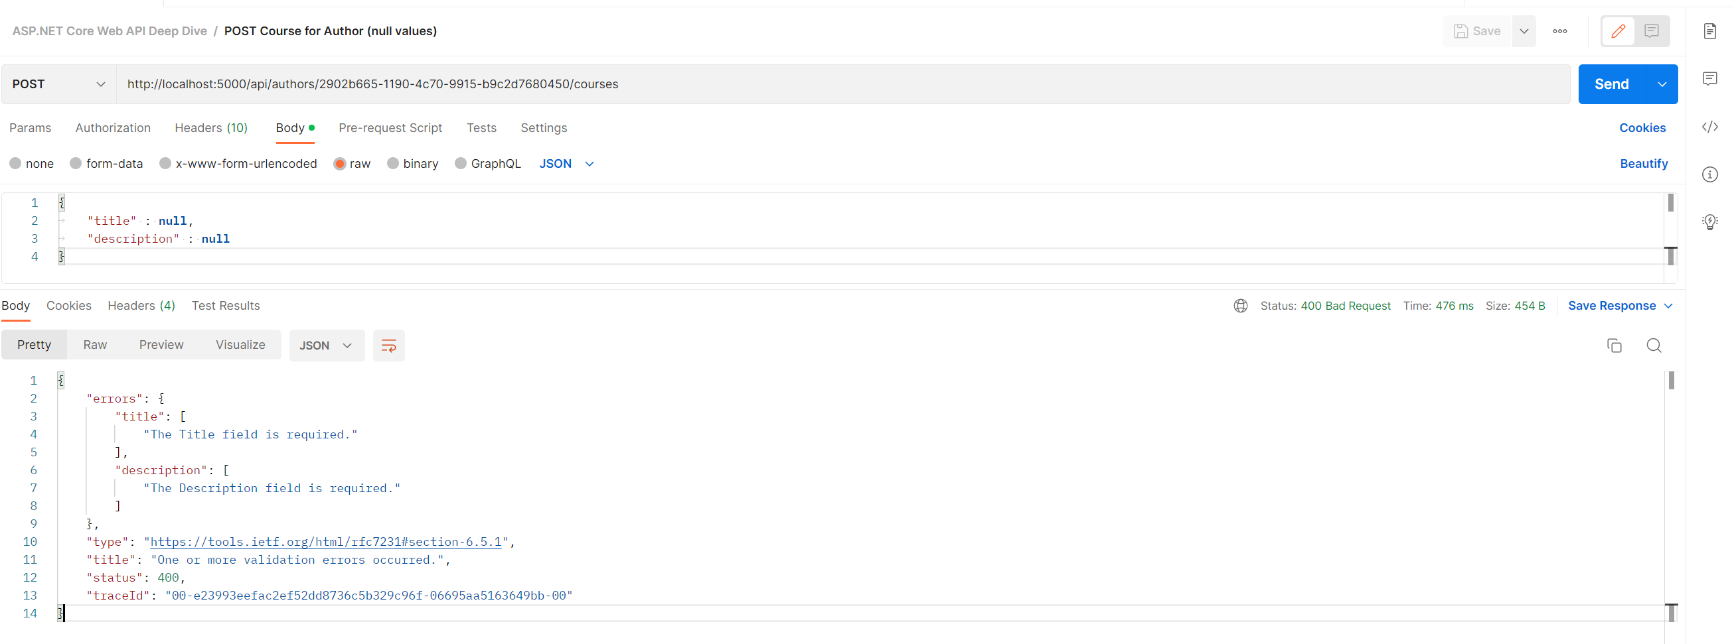
POST COURSE – Null values

Slide 33
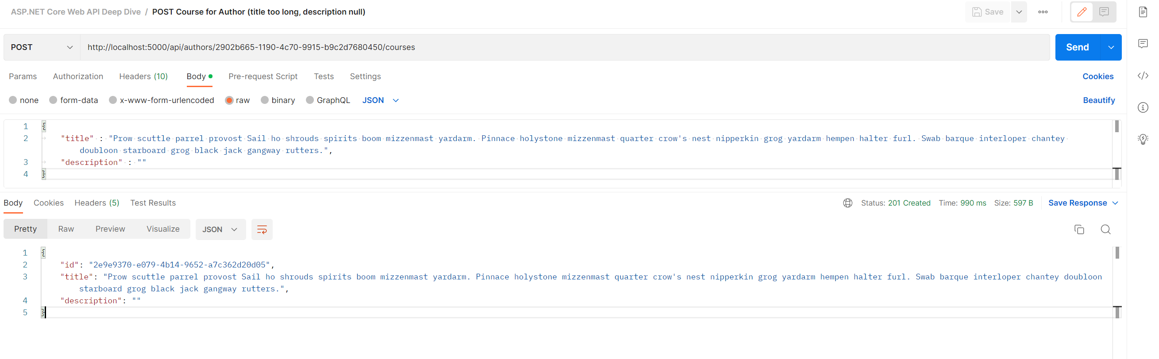
POST Course for Author (title too long, description null)
Created resource.

Slide 34
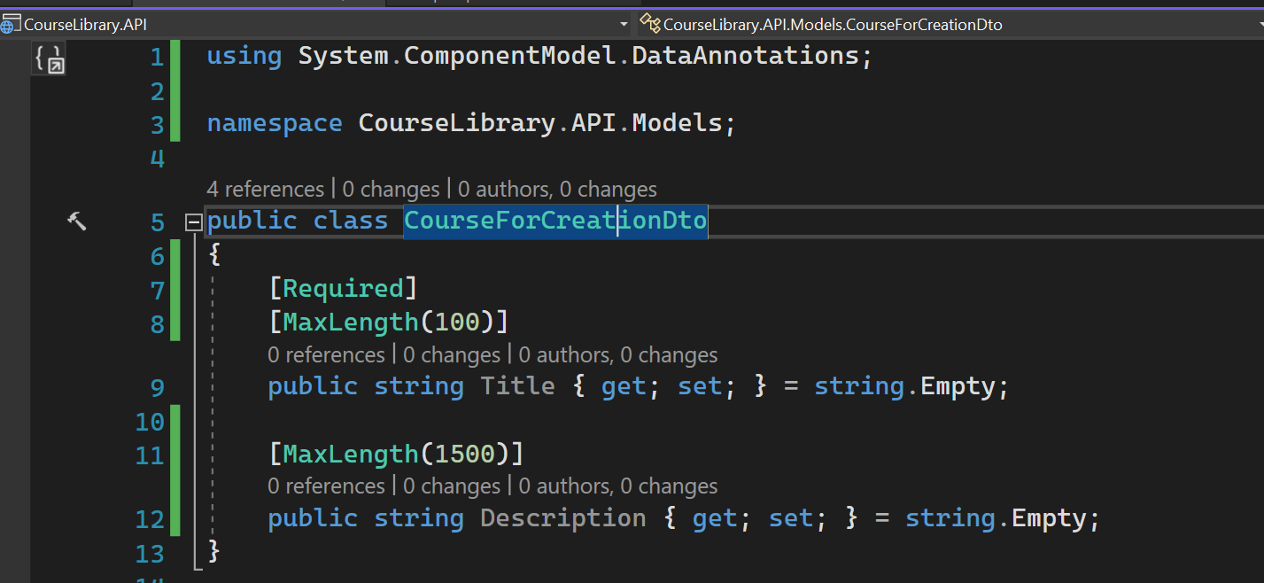
Data annotation attributes

Slide 35
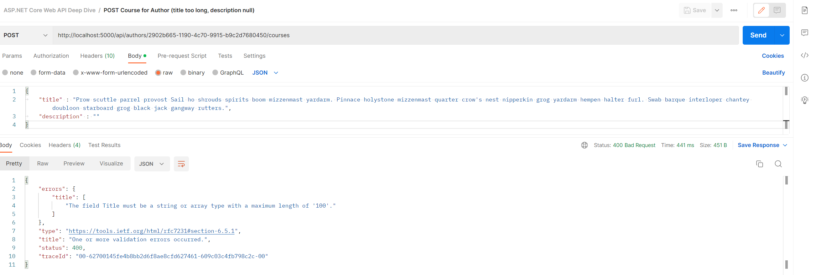
Validation based on data annotation

Slide 36
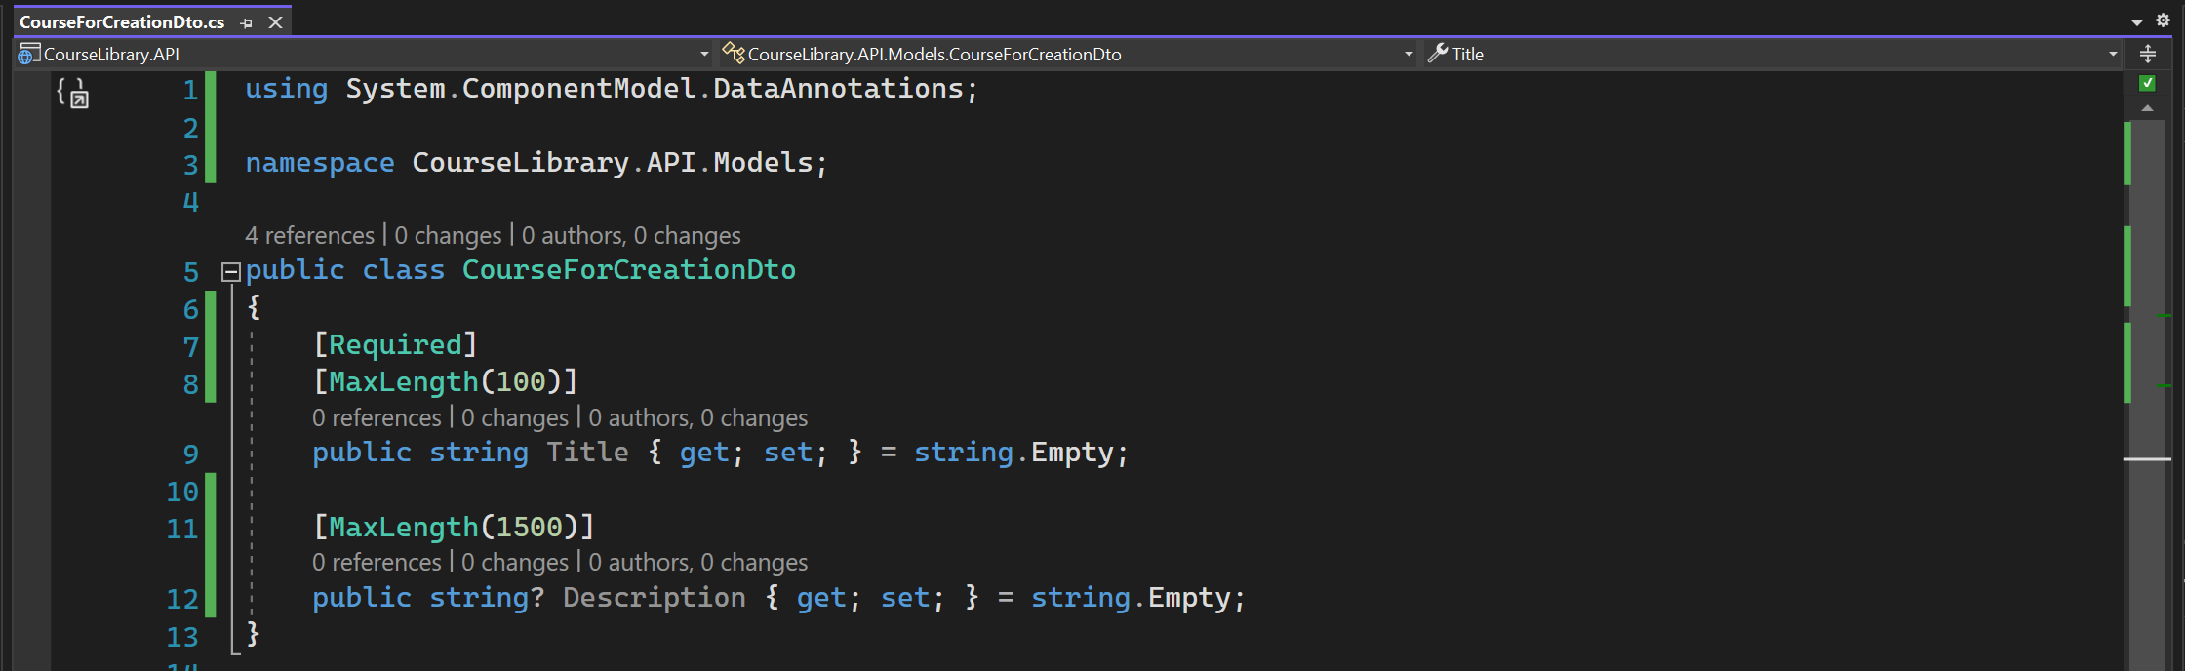
Nullable for description - 1

Slide 37
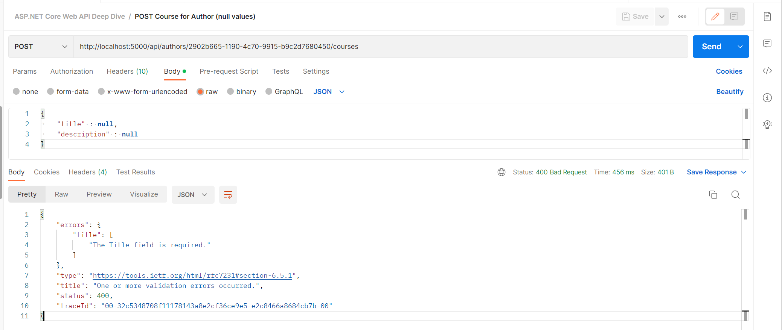
Nullable for description - 2

Slide 38
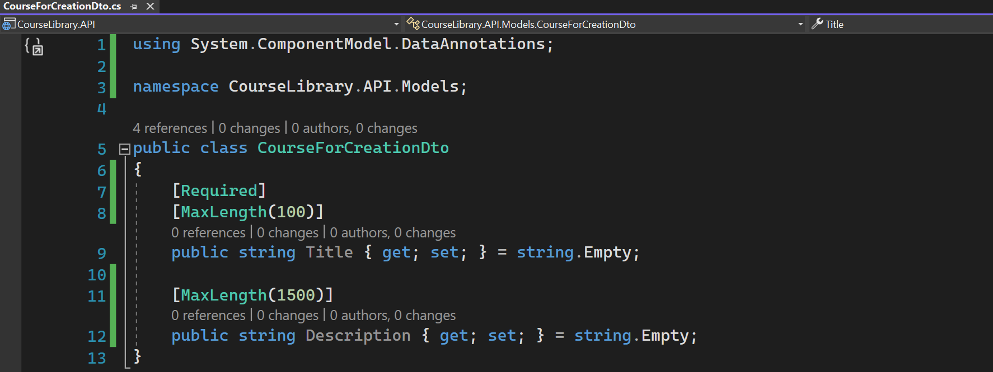
Remove nullable

Slide 39
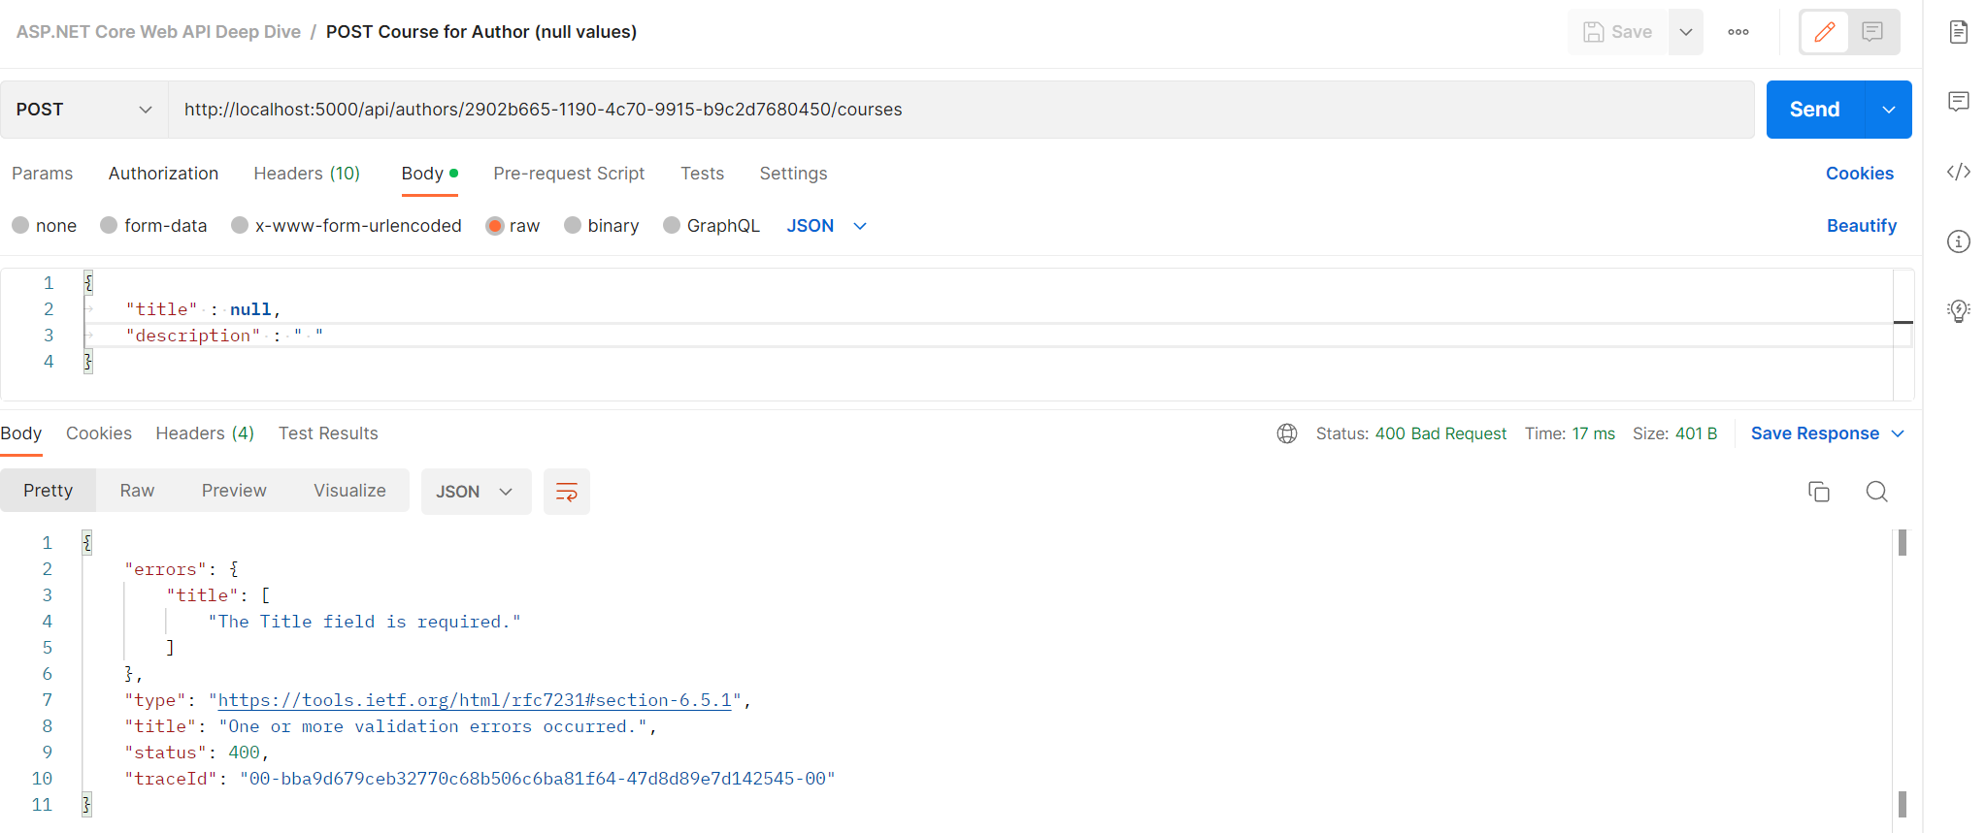
EMPTY DESCRIPTION

Slide 40
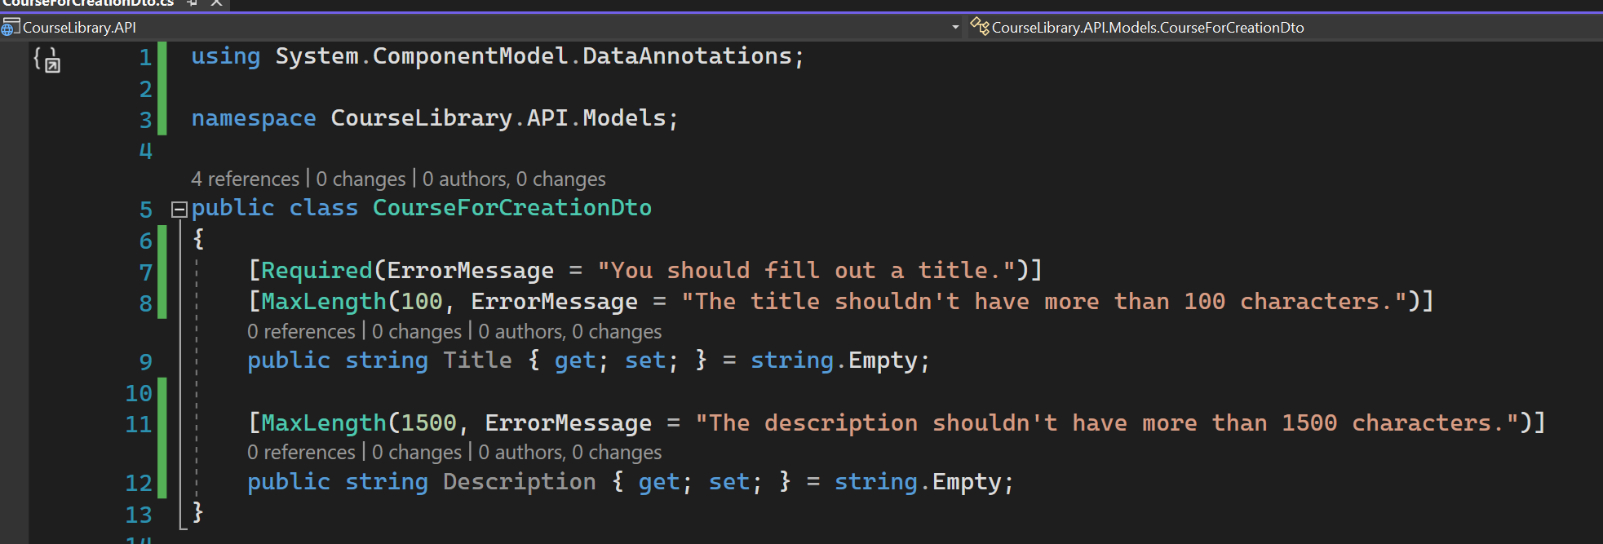
Customize error message - 1

Slide 41
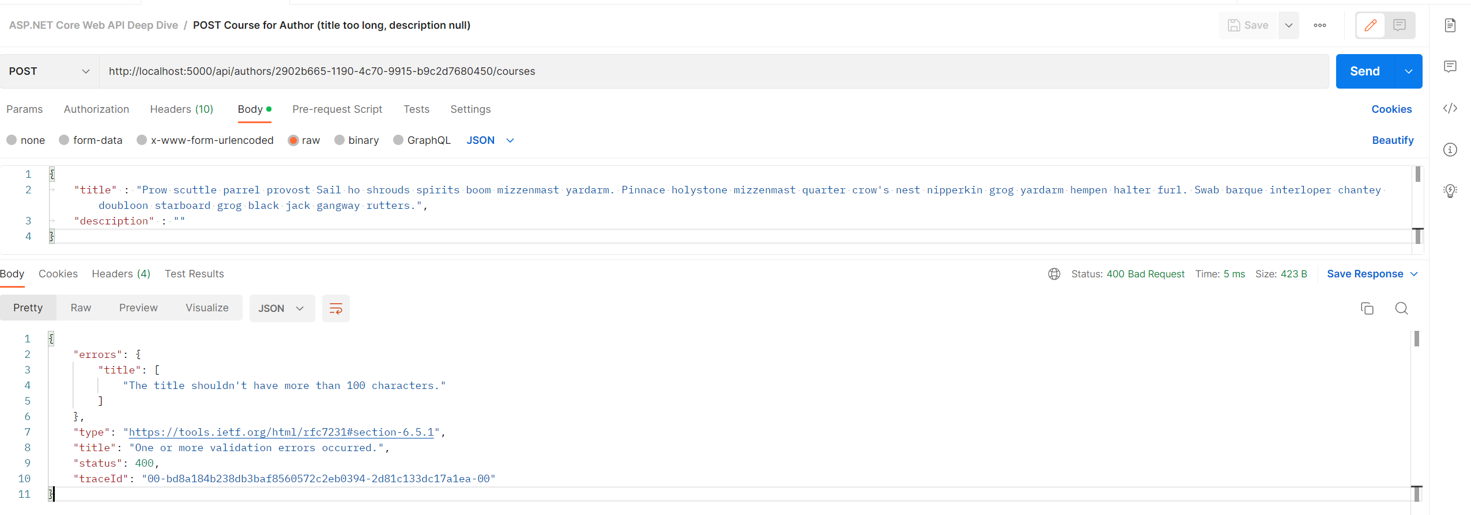
Customize error message - 2

Slide 42
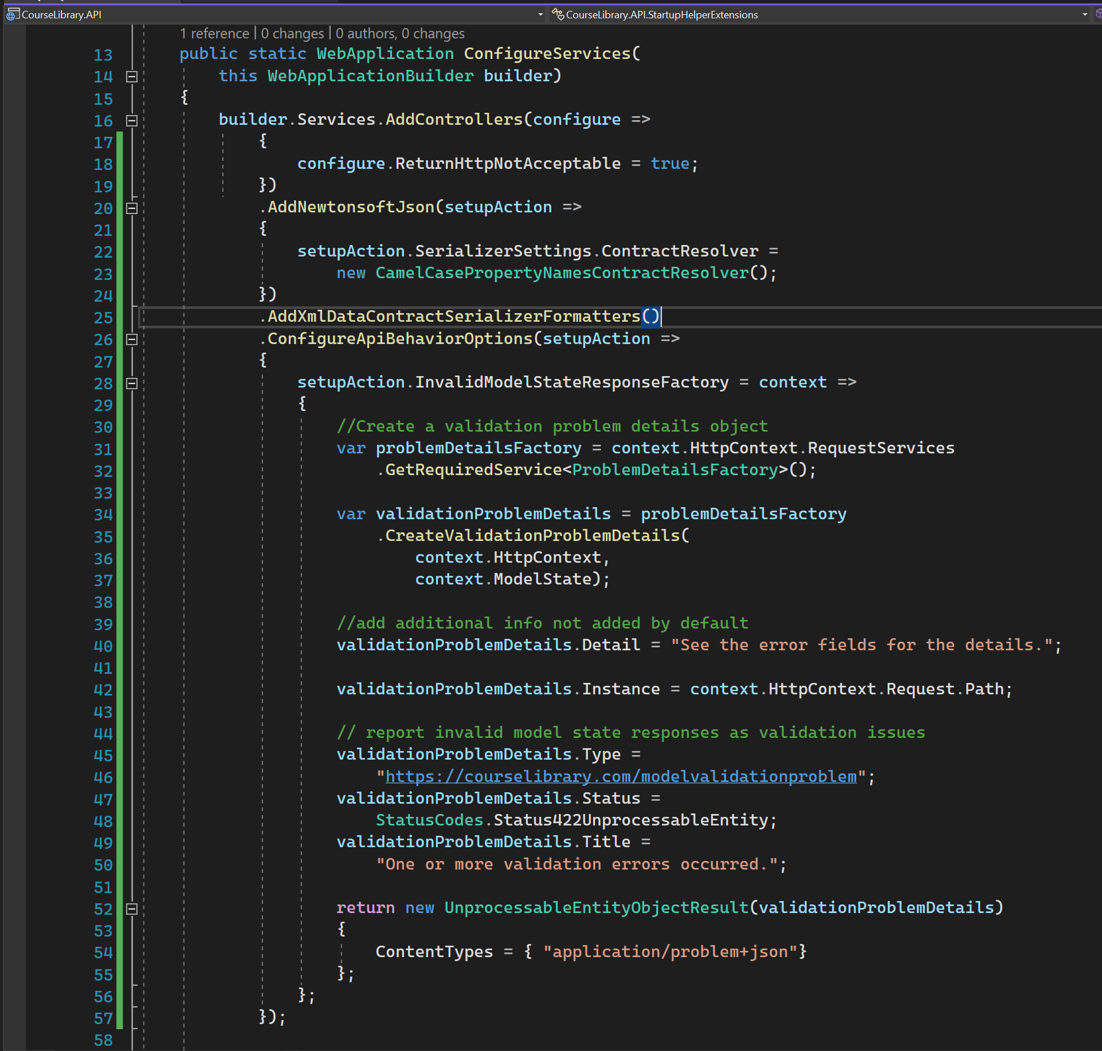
Set it to 422 - 1

Slide 43
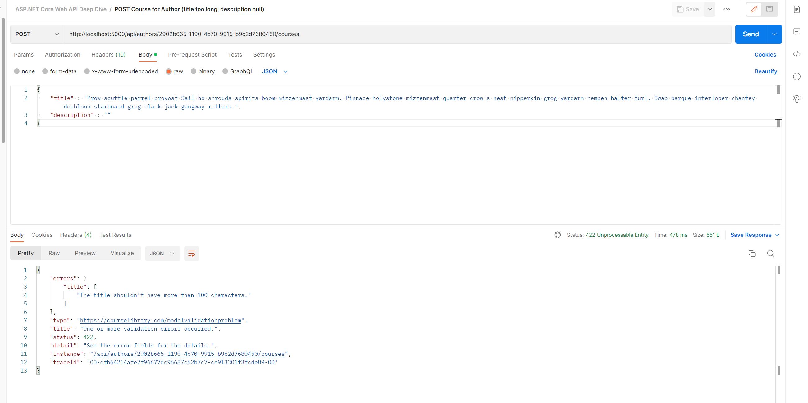
Set it to 422 - 2

Slide 44
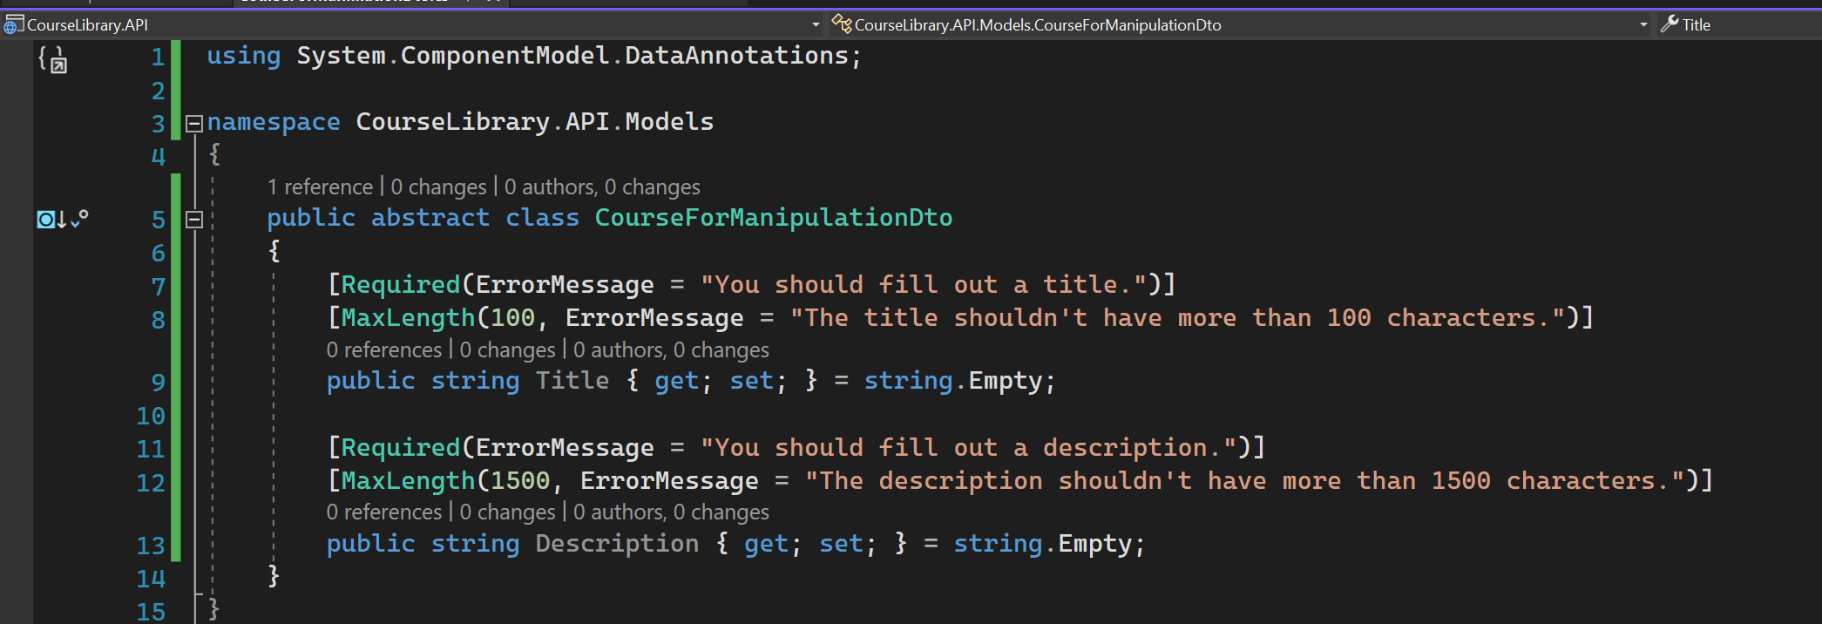
Validation for put - 1

